Slide 1

How Industry Is Addressing Workforce Issues And Drug Testing In The New Era of Legalized Marijuana
Oct. 3, 2018
Presented at the AMOTIA 10th Annual Conference by:
Kathryn J. Russo, Esq.
Jackson Lewis P.C. | Long Island
Kathryn.Russo@jacksonlewis.com
631-247-4606

Slide 2
ABOUT THE FIRM
Represents management exclusively in every aspect of employment, benefits, labor, and immigration law and related litigation.
Over 850 attorneys in 58 locations nationwide.
Current caseload of over 6,500 litigations and approximately 550 class actions.
Founding member of L&E Global.

Slide 3
INTRODUCTORY STATEMENT
The materials contained in this presentation were prepared by the law firm of Jackson Lewis P.C. for the participants’ own reference in connection with educational seminars presented by Jackson Lewis P.C. Attendees should consult with counsel before taking any actions and should not consider these materials or discussions thereabout to be legal or other advice.

Slide 4
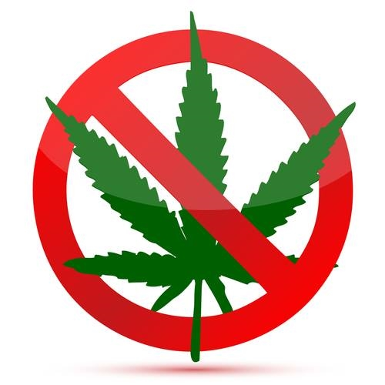
U.S. DOT-REGULATED EMPLOYEES MAY NOT USE MARIJUANA
DOT’s Drug and Alcohol Testing Regulations – 49 CFR Part 40 – do not authorize “medical marijuana” under a state law to be a valid medical explanation for a transportation employee’s positive drug test result… It remains unacceptable for any safety‐sensitive employee subject to drug testing under the DOT’s drug testing regulations to use marijuana.

Slide 5

NON-DOT-REGULATED EMPLOYEES
But what about the workforce that is not regulated by DOT regulations?
You must consider state and locals laws, especially now that there are more and more states permitted medical and/or recreational marijuana use.

Slide 6
RECREATIONAL MARIJUANA LAWS
9 states + DC now have recreational marijuana laws: AK, CA, CO, DC, ME, MA, NV, OR, VT and WA. None of these laws prohibits employment discrimination.
Recreational marijuana can be analogized to alcohol – legal substance, but employers are not required to tolerate its use at work.
With recreational marijuana, the use is not connected to an employee’s disability.

Slide 7

MEDICAL MARIJUANA LAWS
30 states + DC now have medical marijuana laws: AK, AZ, AR, CA, CO, CT, DE, DC, FL, HI, IL, ME, MA, MD, MI, MN, MT, NV, NH, NJ, NM, NY, ND, OH, OK, OR, RI, VT, WA and WV.

Slide 8

Medical Marijuana – Employer-Friendly or Low Risk States
FL and OH – Laws prohibit legal claims against employers who take action against marijuana users.
CA, CO, MI, MT, NM, OR, WA – lawsuits where employers have prevailed.

Slide 9

Medical Marijuana – States Where Risk Is Uncertain
Alaska; D.C.; Hawaii; Maryland; New Hampshire; New Jersey; North Dakota; and Vermont.

Slide 10

Medical Marijuana – States With High Legal Risk For Employers
State medical marijuana laws contain anti-discrimination provisions): AZ, AR, DE, IL, ME, MN, NV, NY, PA, and WV

Slide 11

Medical Marijuana – States With The Most Legal Risk For Employers
Recent court cases ruling against employers who did not hire medical marijuana users: CT, MA and RI.

Slide 12

Medical Marijuana – States With The Most Legal Risk For Employers
Oklahoma – new medical marijuana law took effect on July 26, 2018.
There are no “qualifying medical conditions,” meaning marijuana will be easy to obtain;
Discrimination by employers against medical marijuana users is prohibited;
Employers may not take action against the holder of a medical marijuana license solely based upon the results of a drug test showing positive for marijuana or its components.

Slide 13

FEDERAL CONTRACTORS
Connecticut -- On Sept. 5, 2018, a federal court in Connecticut held that an employer’s refusal to hire a medical marijuana user constitutes employment discrimination. The fact that the employer was a federal contractor did not matter because the DFWA does not require drug testing and does not regulate off-duty conduct. The Court declined to award punitive damages or attorneys’ fees. Noffsinger v. SSC Niantic Operating Co., LLC, d/b/a Bride Brook Health & Rehab. Ctr., (D. Conn. Sept. 5, 2018).

Slide 14
INDIVIDUALIZED ASSESSMENT
Train your Human Resources employees and other managers and supervisors on handling the “interactive dialogue,” the “individualized assessment” and “direct threat analysis” required by the Americans with Disabilities Act and comparable state laws.
These are complex issues. You may need to obtain additional information from the employee’s treating physician.
Do not make stereotyped assumptions about whether the employee can perform the job, or whether their medication is too dangerous.

Slide 15

INDIVIDUALIZED ASSESSMENT
Must make an individualized assessment as to whether the employee’s prescription drug use actually affects his/her ability to safely perform the job.
Cannot just “speculate” about “possible safety concerns.” EEOC v. Hussey Copper Ltd. (W.D. Pa. Mar. 10, 2010).
Determination must be based on “the best available objective evidence.”
Must engage in interactive process to determine whether a reasonable accommodation exists that would allow the employee to perform his/her job duties in a safe manner, such as:
Temporary reassignment;
Leave of absence (beyond FMLA);
Modification of equipment, devices or shift;
Job restructure.

Slide 16
DIRECT THREAT ANALYSIS
Direct threat analysis:
“A significant risk of substantial harm to the health or safety of the individual or others that cannot be eliminated or reduced by reasonable accommodation.”
Consider: (i) the duration of the risk; (ii) the nature and severity of the potential harm; (iii) the likelihood that the potential harm will occur; and (iv) the imminence of the potential harm.

Slide 17

DISABILITY DISCRMINATION
The success of most disability discrimination cases will depend upon:
The employer’s interactive process and
The attempts at reasonable accommodation.

Slide 18

Drug Testing Programs – Best Practices
Discuss your drug testing policy and procedures with your Medical Review Officer – do not let MRO decide what your policy will be!! (e.g., do not let MRO decide whether a medical marijuana card excuses a positive test result). Ultimately, it is the employer who must make the employment decision (and comply with applicable laws), so ensure that your MRO will advise you when a medical marijuana card is presented to excuse a positive drug test result.

Slide 19
Best Practices – Final Thoughts
Following federal law may no longer be a best practice, as evidenced by the court decisions in CT, MA and RI, as well as the new OK medical marijuana law.
It’s all about Safety: If you employ safety-sensitive employees, you must weigh whether to comply with state medical and recreational marijuana laws against the greater legal risk that a known marijuana user causes an accident that injures/kills people.

Slide 20
Best Practices – Final Thoughts
There is more legal risk when the employee is not employed in a safety-sensitive job.
The courts are receptive to claims asserted by disabled employees.
The majority of Americans support medical marijuana and legalized marijuana.
More states are poised to vote on marijuana laws in November.

Slide 21

STAY UP TO DATE…
Stay up to date on the latest:
Consider signing up for our blog
http://www.drugtestlawadvisor.com/

Slide 22
QUESTIONS?
If you have questions or would like to discuss drug testing and substance abuse issues further, you may contact me:
Kathryn J. Russo
Kathryn.Russo@jacksonlewis.com
Tel.: (631) 247-4606

